Slide 1

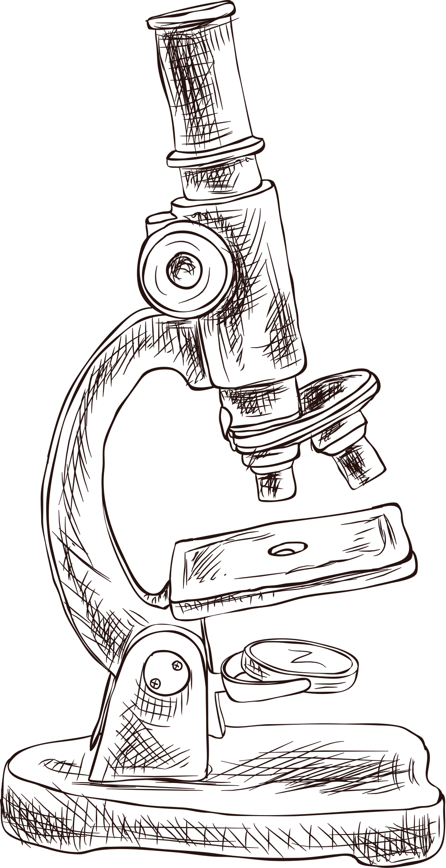
Wine quality
Risk calculator
PRESENTED BY
Marta garcía luceño
Notes:
“This project is called Wine Quality Risk.
It’s a system that helps make quality control decisions using chemical data.”

Slide 2

1- INTRODUCTION
2- OBJECTIVES
3- METHODOLOGY
Table
of Contents
4- ANALYSIS & INSIGHTS
5- EDA
6- MODEL SELECTION & VALIDATION
7 -CONCLUSIONS
Notes:
“I’ll briefly walk through the project, from the problem and methodology to the analysis, model selection, and conclusions.”

Slide 3

1-Introduction
PREDICTING THE PROBABILITY OF LOW-QUALITY WINE BASED ON CHEMICAL COMPOSITION
PROJECT: WINE QUALITY RISK
PREVENTIVE ML SYSTEM FOR WINE QUALITY CONTROL
IRONHACK – CASE STUDY
Notes:
“We mainly focus on using chemical data to detect low-quality risk early and support wine quality control decisions.”

Slide 4
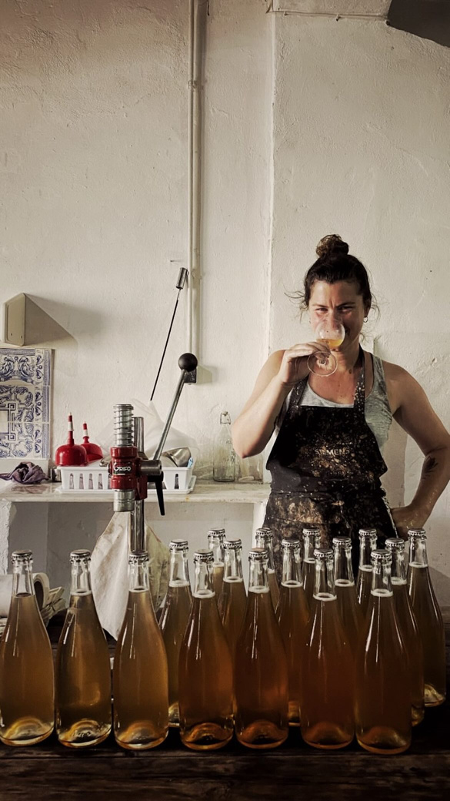



Context
A problem I’ve faced as a winemaker
I work with decisions made long before quality can be evaluated
Low technical quality harms our brand trust over time
Need for early-warning decision support. Most quality feedback arrives late — when intervention is no longer possible
MARTA GARCÍA
Wine Maker & Data Analyst
Notes:
“This project comes from a real problem I am facing as a winemaker.
Quality feedback usually arrives too late, when intervention is no longer possible, and low technical quality can damage our brand trust over time.”

Slide 5
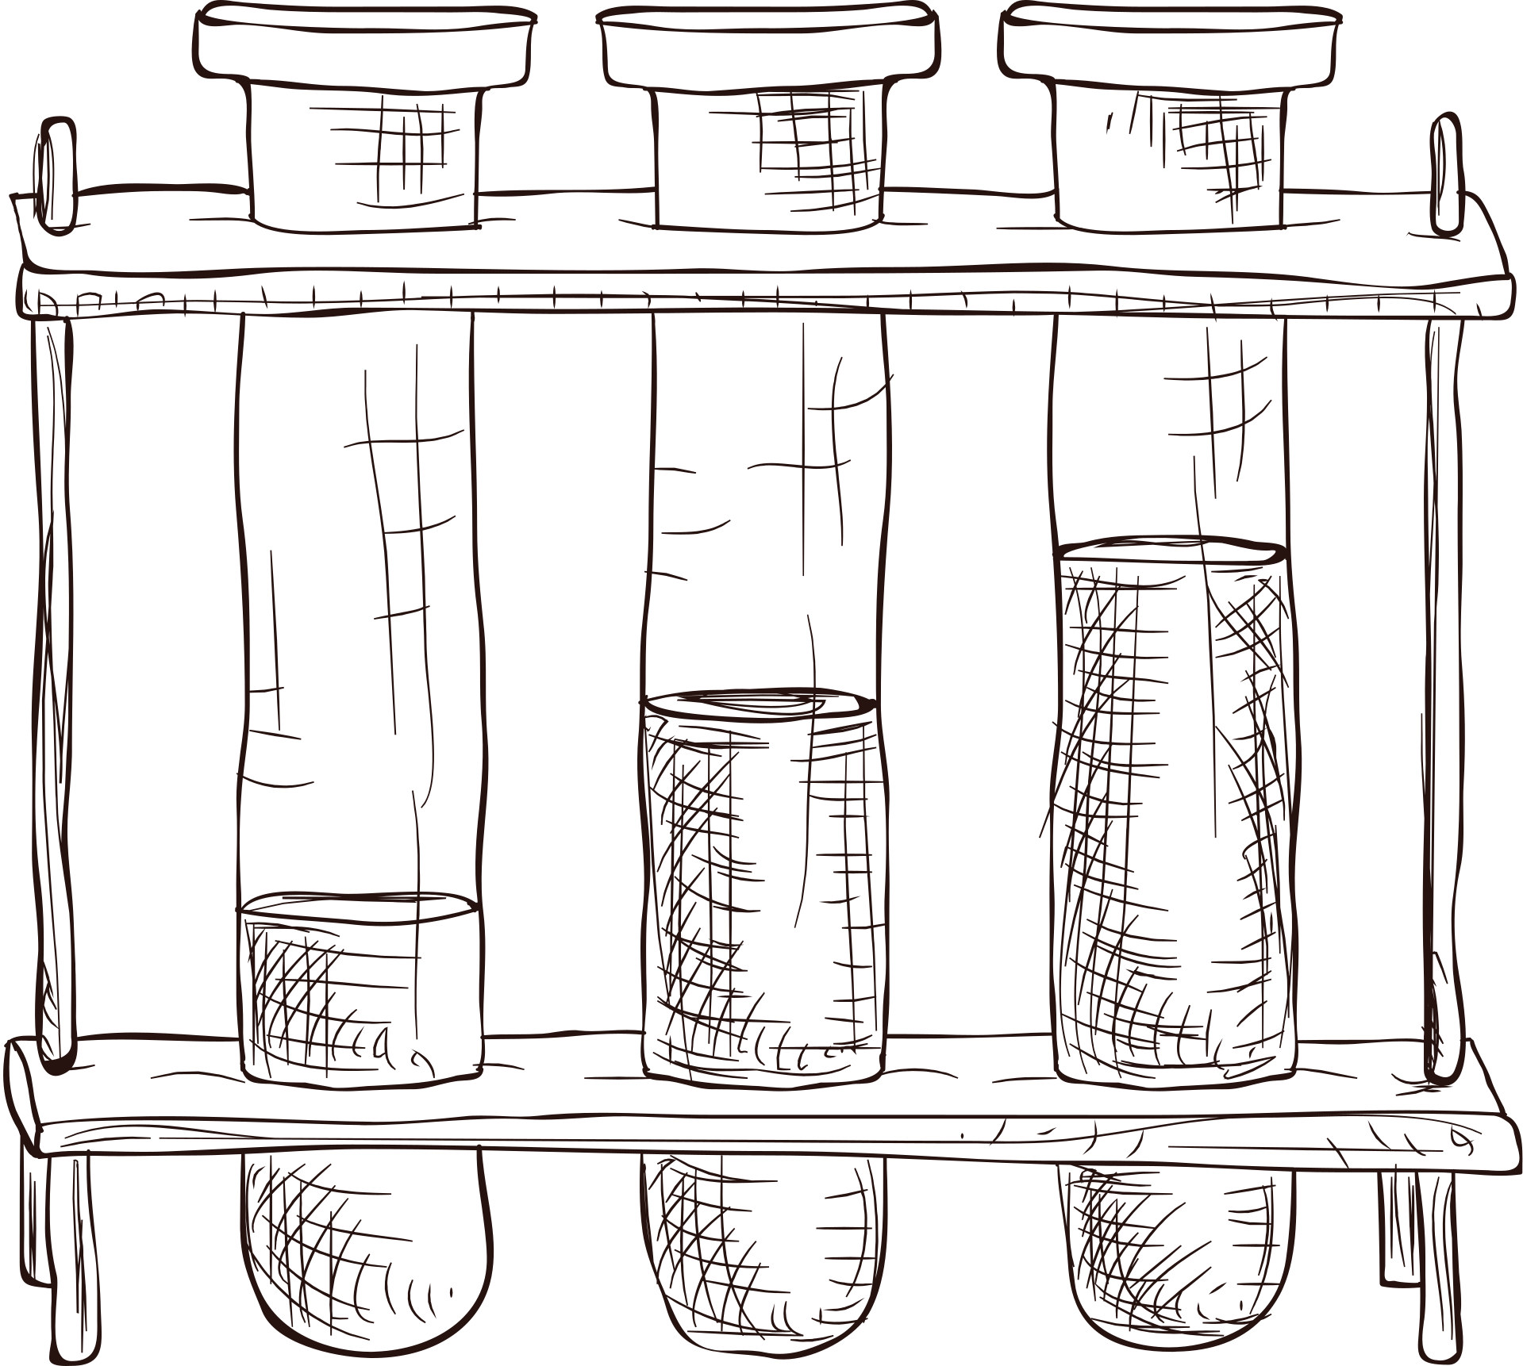

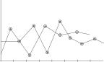


2- Project objective
Build ML system using chemical composition only
Predict risk of low technical quality
Support preventive business decisions
Notes:
“The goal of this analysis is to use chemical data to detect low-quality risk early.
It’s designed to support preventive decisions, rather than predict a quality score.”

Slide 6

Business cost asymmetry
FALSE NEGATIVES = HIGHEST COST
FALSE POSITIVES = ACCEPTABLE CONSERVATIVE COST
THEREFORE: RECALL-FIRST DECISION POLICY
Notes:
“We call this Business Cost Asymmetry because, in this context, not all mistakes cost the same.
Missing a low-quality wine is much more expensive than flagging one that later turns out to be fine.
That’s why we focus first on catching high-risk wines, even if it means accepting more false alarms.”

Slide 7

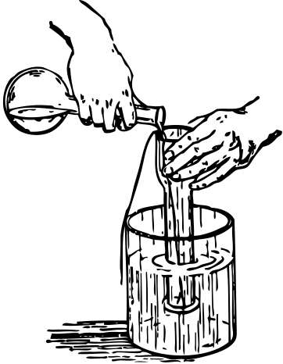
3- Methodology overview
06
SUPERVISED ML CLASSIFICATION
TRAIN / VALIDATION / TEST SPLIT
THRESHOLD TREATED AS BUSINESS DECISION
VALIDATION-DRIVEN MODEL SELECTION
Notes:
“Because not all mistakes cost the same, we framed this as a risk decision.
We split the data to test the system properly, and we treated the risk cutoff as a business choice, not a fixed rule.
From there, we chose the model that best avoids missing high-risk wines.”

Slide 8

Evaluation framework
PRIMARY METRIC: RECALL (RISK=1)
SUPPORTING METRICS: PRECISION, ACCURACY
THRESHOLD TUNING ON VALIDATION ONLY
FROZEN THRESHOLD BEFORE TEST & DEPLOYMENT
CALIBRATION TESTED (NO FINAL GAIN)
Notes:
“This slide summarizes how we evaluated the models.
Recall for high-risk wines is the main metric, because missing risky cases is the most costly error.
Thresholds were adjusted using only the validation set and then frozen before testing and deployment.
We also tested calibration, but it didn’t improve results, so it wasn’t included in the final system.”

Slide 9


Modeling workflow
BASELINE
THRESHOLD TUNING
DEPLOYMENT
MODEL COMPARISON
FINAL SELECTION
NO TEST LEAKAGE
SAME VALIDATION SPLIT FOR ALL MODEL
Notes:
“We followed a clear step-by-step process.
We started simple, comparing all models using the same validation data, adjusting the threshold, and then selecting and deploying the final model without using the test set.
This way, all models were compared fairly.”

Slide 10

4- ANALYSIS AND INSIGHTS

Slide 11

Data Setup and Engineering

Slide 12


Dataset
Physicochemical wine dataset
Chemical attributes only
Expert quality score as base target
Notes:
“The analysis is based only on chemical data from the wine.
We don’t use market reviews or any external information.
The expert quality score is used as a reference to define what we consider low-quality risk.”

Slide 13

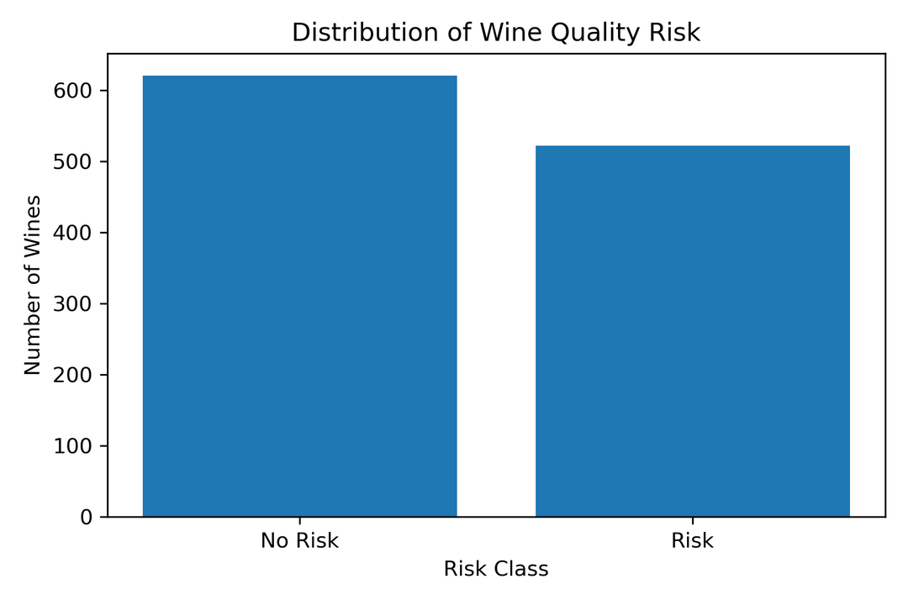
Risk target construction
RISK = 1
IF QUALITY ≤ 5
RISK = 0
OTHERWISE
BINARY CLASSIFICATION FRAMED AS BUSINESS RISK
Notes:
“The chart first shows that high-risk and low-risk wines are fairly balanced.
This means we’re working under solid and realistic conditions.
Then we define risk as wines with a score of five or lower, which turns the problem into a simple yes-or-no decision.”

Slide 14


Data integrity checks
Min / max / percentiles sanity checks
Clean schema
No feature elimination
Notes:
“Before building the models, we first checked that the data made sense.
We looked at minimums, maximums, and general ranges, and didn’t find any invalid or inconsistent values.
We also decided to keep extreme values, because in this context they often represent real risk cases, not data errors.”

Slide 15

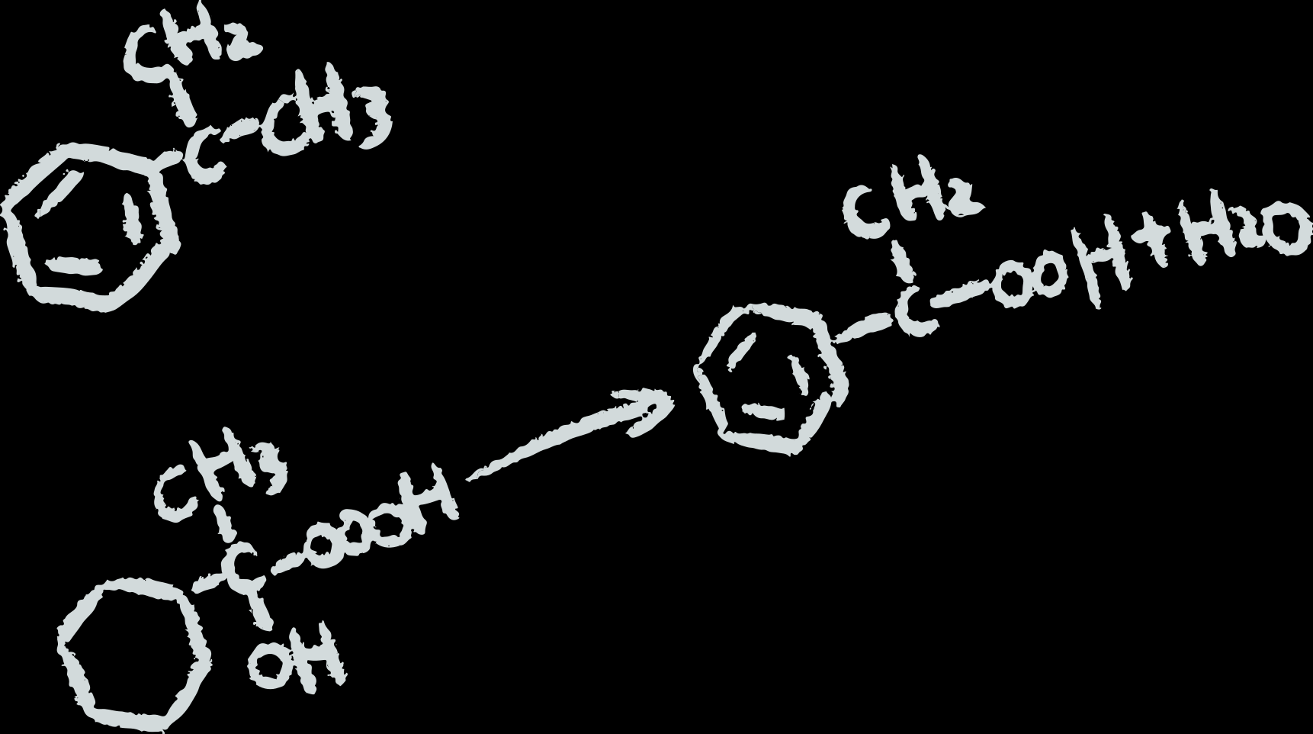
5- EDA

Slide 16




EDA goals
Understand distributions
Inspect feature–quality relationships
Prepare for modeling (no decisions yet)
Notes:
“In the exploratory analysis, we focused on understanding the data itself.
We looked at how the variables are distributed and how chemical features relate to quality.
At this stage, the goal was only to understand the data and no modeling decisions were made yet.”

Slide 17




EDA insights
Alcohol & volatile acidity show strong relation with quality
Non-linear tendencies in some variables
Mutual Information used for dependency inspection
Alcohol range filtering tested (no improvement)
Notes:
“When we explored the data, alcohol and volatile acidity clearly stood out.
We also saw that some relationships weren’t straightforward, so we tested more flexible approaches.
We tried filtering by alcohol ranges as well, but since it didn’t help, we left it out.”

Slide 18
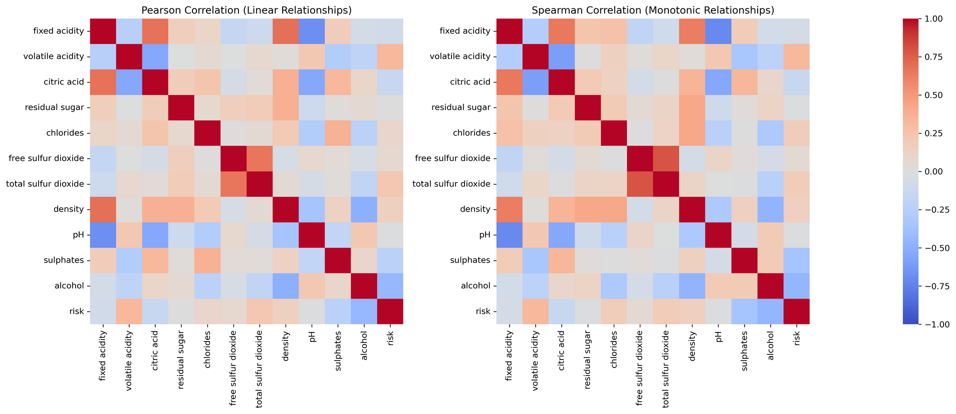
Feature Relationships
(Correlation Heatmaps)
Since both heatmaps were almost identical, we confirmed that no additional hidden structure was being missed in the data.
Notes:
“Here we checked the relationships in two different ways, and they told the same story.
Since the results were almost identical, we were confident there wasn’t any hidden pattern that we were missing.”

Slide 19
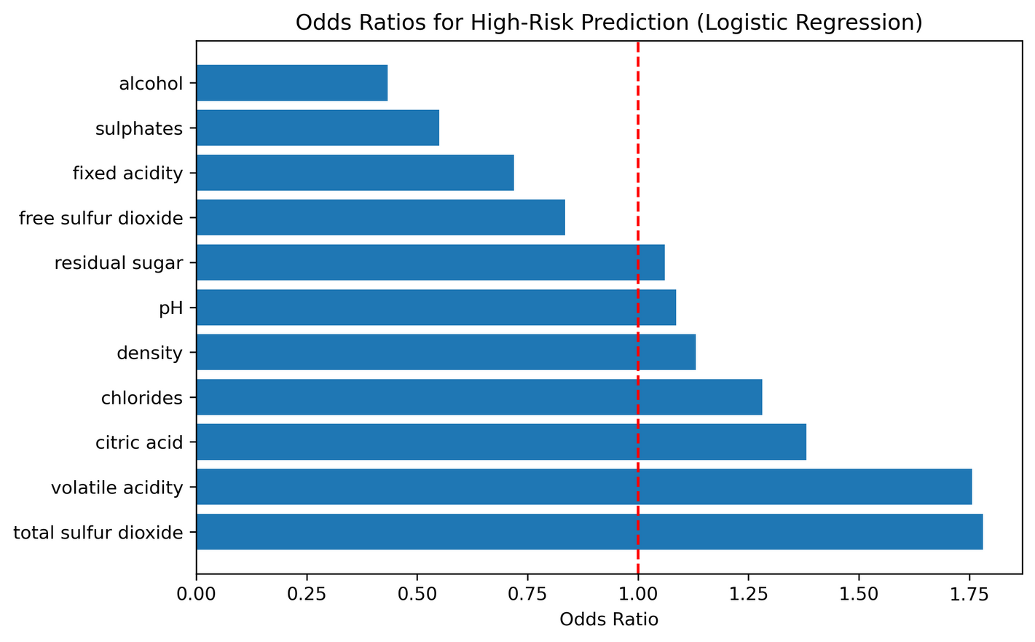
Baseline interpretability
(Odds Ratios)
Logistic Regression used as interpretable baseline
Odds ratios highlight risk amplifiers and protectors
Interpretation used for insight, not final prediction
Notes:
“We used a simple baseline model to understand the drivers behind risk.
This chart shows which factors increase risk and which ones help protect the wine.
Here was about learning from the data, not making the final prediction.”

Slide 20

6-Model Selection & Validation

Slide 21
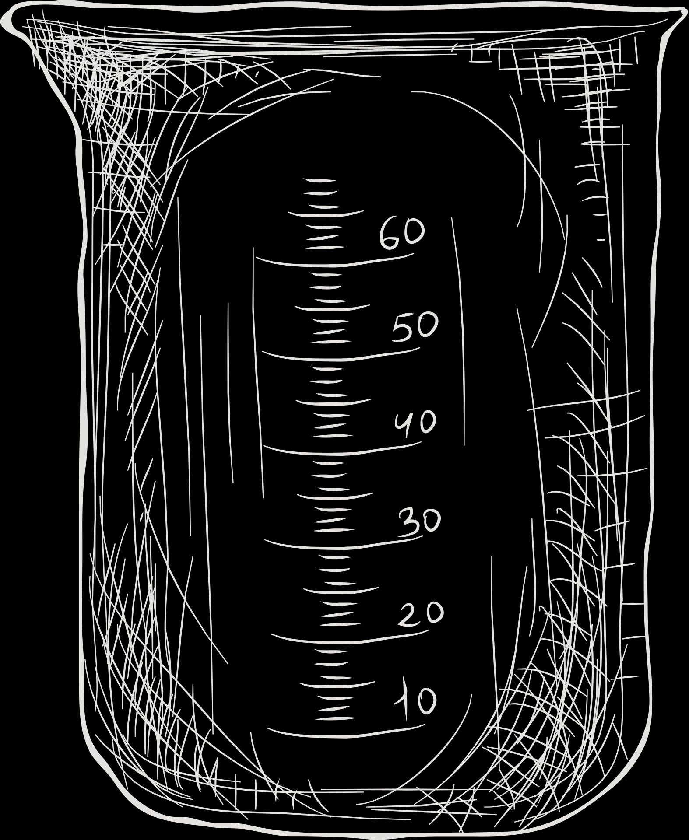
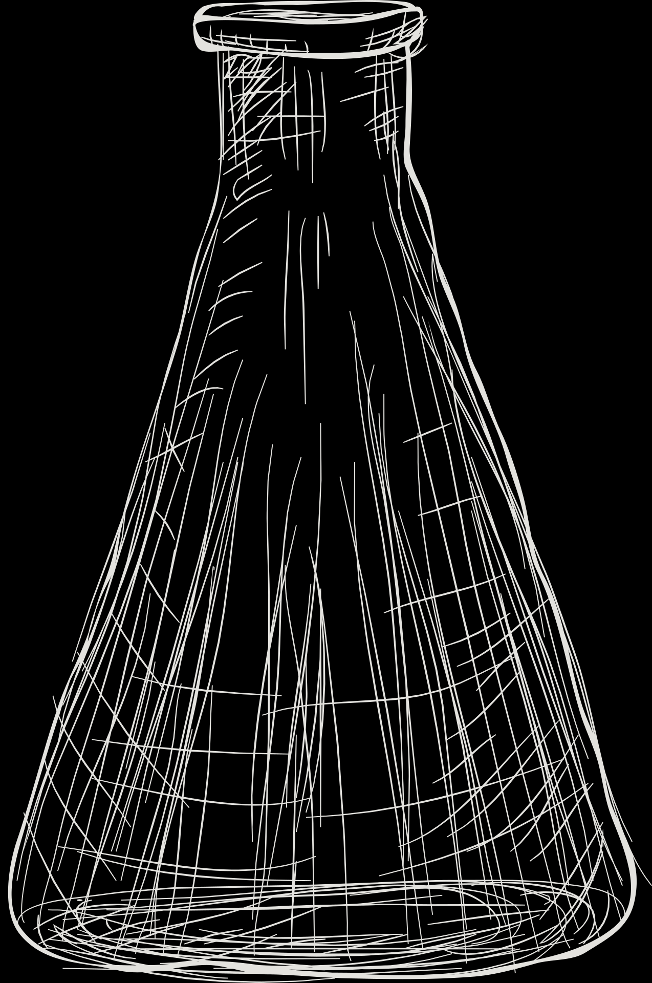
Threshold tuning logic
THRESHOLD OPTIMIZED PER MODEL ON VALIDATION
ENFORCE RECALL TARGET
RECALL INTENTIONALLY EQUALIZED
Notes:
“Before comparing the models, we first made sure they were all playing by the same rules.
For each one, we adjusted the risk cutoff using validation data so that all of them caught the same minimum level of high-risk wines.
This way, the comparison is fair and fully aligned with the goal of not missing low-quality wines.”

Slide 22
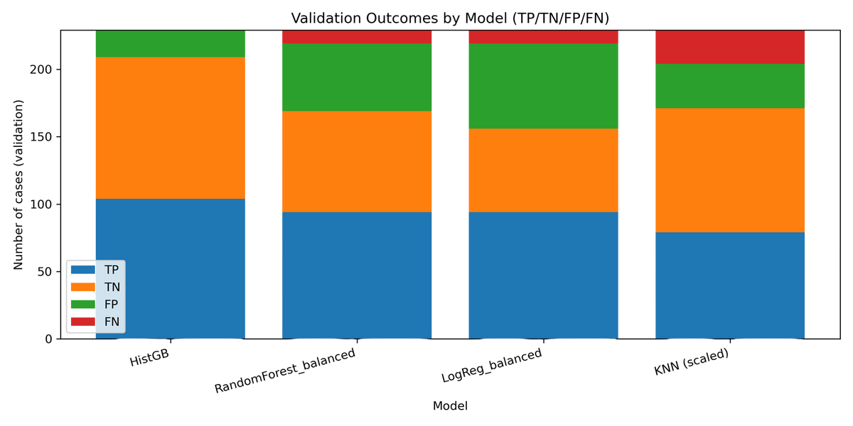
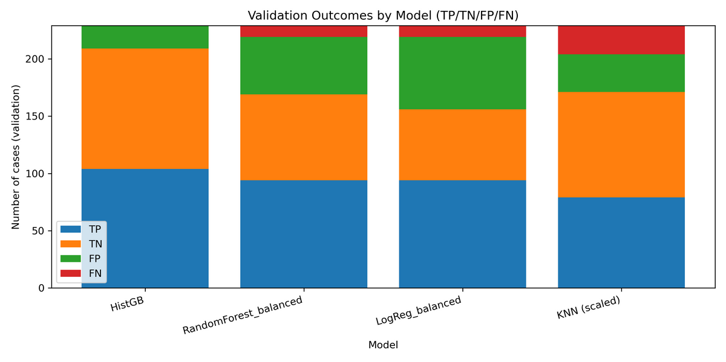
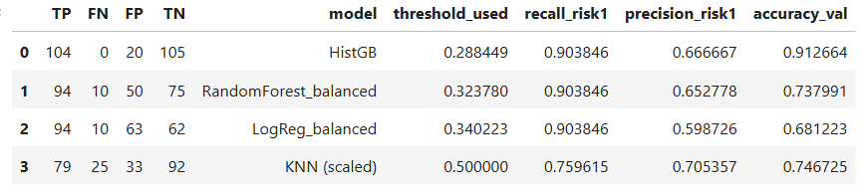

Model Evaluation & Comparison
LOGISTIC REGRESSION (BASELINE)
KNN (EXPERIMENTAL BASELINE)
RANDOM FOREST
HISTOGRAM GRADIENT BOOSTING
Notes:
“This table brings together how each model behaves and where mistakes happen.
Because missing a risky wine is the worst outcome for us, that was the main focus.
Histogram Gradient Boosting handled that best, without missing any high-risk wines in validation.”

Slide 23
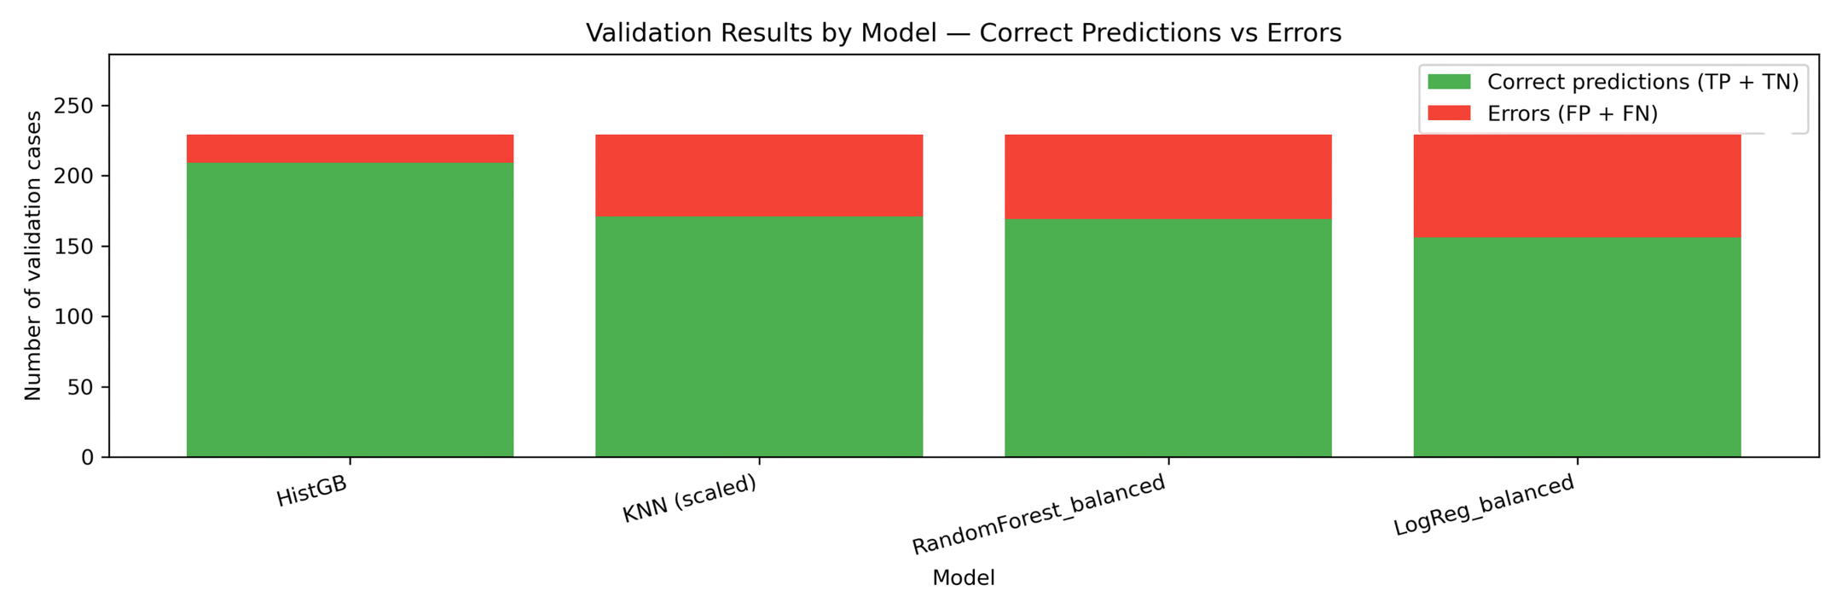
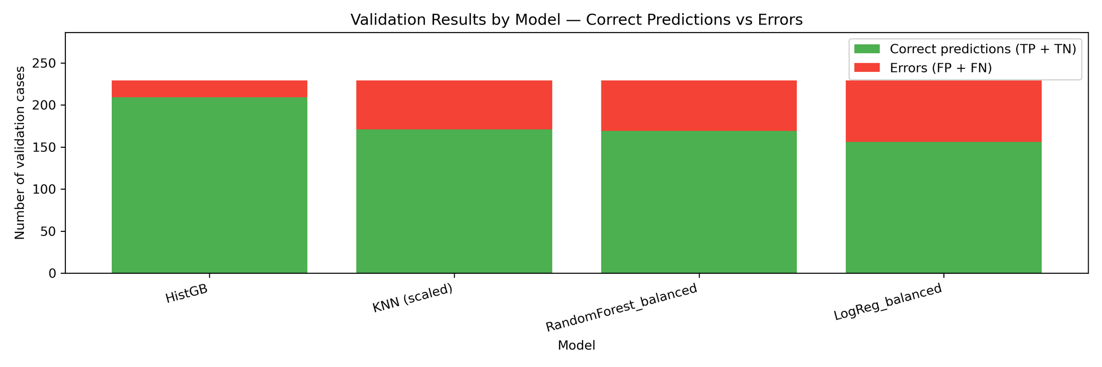
Key selection visual
HISTGB MINIMIZES ERRORS
Notes:
“This visual makes the comparison very easy to see.
Green means things go as expected, red means problems.
Histogram Gradient Boosting avoids the most serious mistakes, so it was the clear choice.”

Slide 24

7-CHALLENGES, CONCLUSIONS, NEXT STEPS

Slide 25


Challenges
Asymmetric business cost
Threshold as policy decision
Avoiding test leakage
Limited dataset size
Notes:
“The main challenges of the project include: handling asymmetric business costs, treating the decision threshold as a policy decision, avoiding test leakage, and working with a limited dataset size.”

Slide 26


Conclusions
Early chemical composition provides a reliable signal to detect low-quality risk before sensory evaluation.
Model comparison confirmed that Histogram Gradient Boosting provides the most stable performance under a recall-constrained setting.
Notes:
“What we’ve shown is that by looking only at the chemical side of the wine, we can already analyze it and get very strong signals of what a low-quality wine looks like.
Based on that, and after comparing models under a risk-focused setup, we made our model's choice.”

Slide 27




Deployment
Streamlit risk calculator
Real-time inference
Ready for live demo
Notes:
“This is the practical part.
We built a simple risk calculator where you input the chemistry and immediately see the risk.
It’s ready for a live demo.”

Slide 28



Limitations
No external winery validation
Subjective expert scores
No causal interpretation
Notes:
“Like any project, this one has some limits.
We didn’t validate it directly with other wineries, the quality scores come from human tasters, and the model shows patterns, not cause and effect.”

Slide 29

Next steps
Cost-based threshold refinement
External data validation
Monitoring after deployment
Integrate market reviews to compare technical risk vs market perception
Notes:
“Next steps include validating it with external data and tracking how it behaves in practice.
We’d also like to compare technical risk with market perception and fine-tune the threshold based on real costs.”

Slide 30
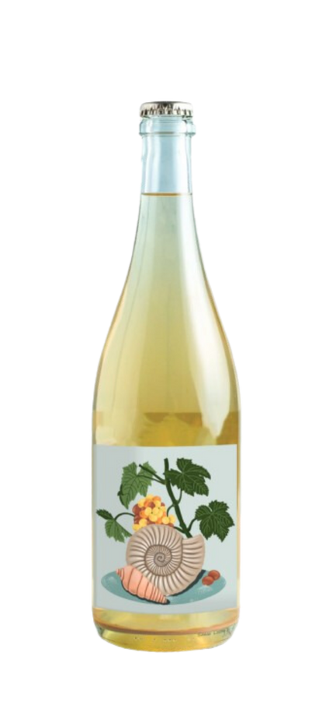
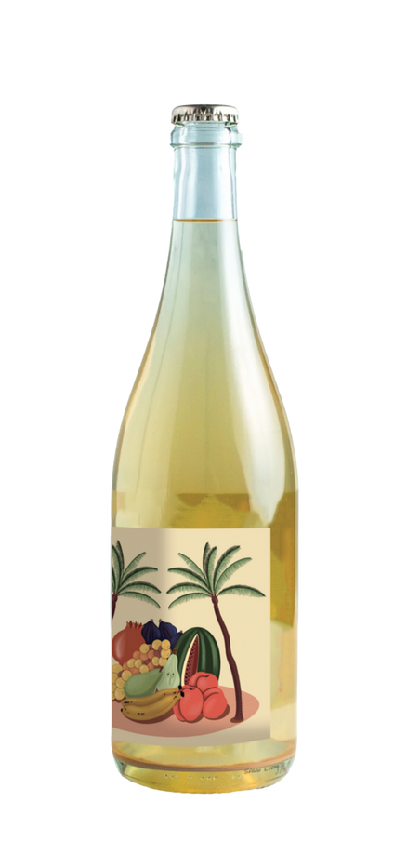
Case Study
Wine 1
Wine 2
Preventive Action
High risk driven by high volatile acidity and sulfur-related imbalance, a correctable factor.
Risk managed through targeted production adjustments.
Strategic Mitigation
High risk driven by low alcohol (~10%), a non-correctable factor
Risk managed through pricing and marketing strategy.
Notes:
“And finally, here we show two wines with a similar risk signal, but very different actions.
In Wine 1, the risk comes from volatile acidity and sulfur imbalance, so it’s something we can act on directly in production.
In Wine 2, the risk is driven by low alcohol, which we can not fix, so the decision goes to pricing and marketing instead.”

Slide 31
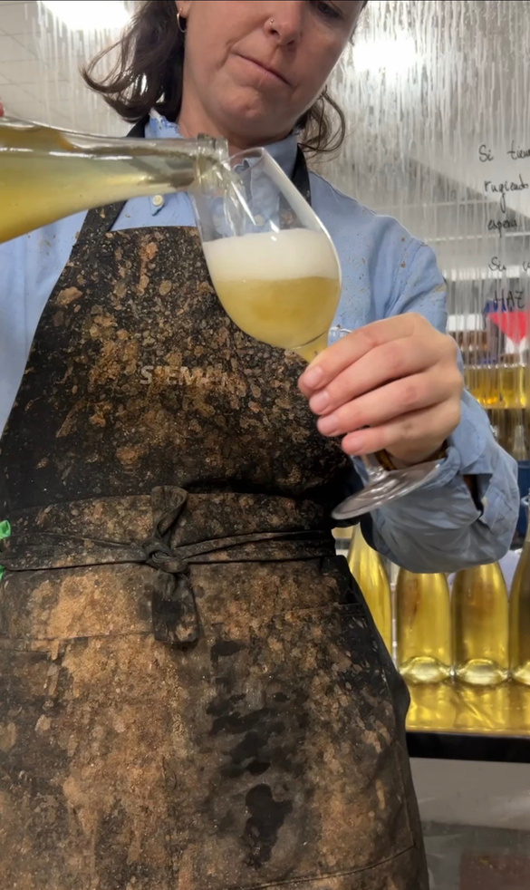
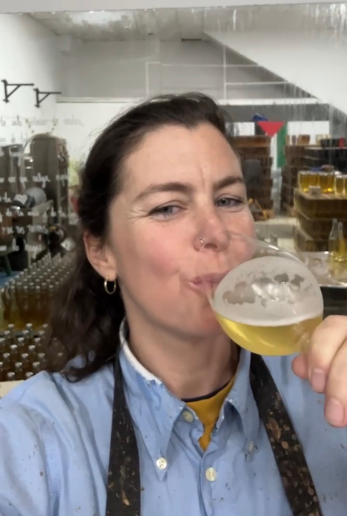
Thank you
Salud!

